Slide 1
Course Title Data Mining
Course Code: PM-ASDS 18
Lecture-06: Principal Component Analysis (15.11.2024)
Presented by
Nasrin Khatun
Assistant Professor
Department of Statistics
Jahangirnagar University

Slide 2
Dimensionality reduction
Principal component analysis means dimensionality reduction. Dimensionality reduction refers to the techniques that reduce the number of input variables in a data set.

Slide 3
Why dimensionality reduction is needed?
Less computation or less training time.
Redundancy is removed after removing similar types of dataset.
Space required to store the data is reduced.
Excluding unnecessary features and including important features.
Helpful for human interpretations.

Slide 4
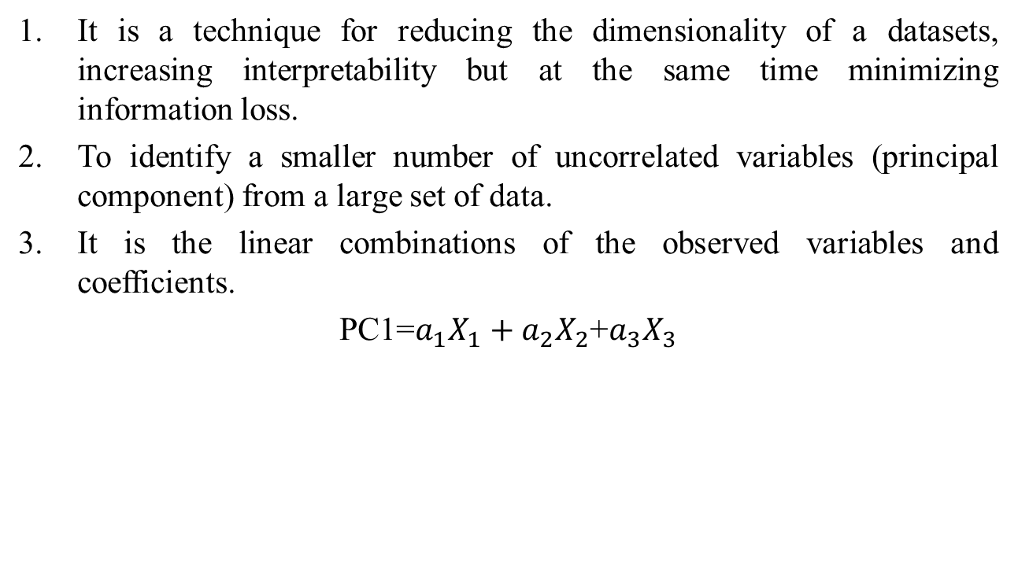
Principal Component Analysis
It is a technique for reducing the dimensionality of a datasets, increasing interpretability but at the same time minimizing information loss.
To identify a smaller number of uncorrelated variables (principal component) from a large set of data.
It is the linear combinations of the observed variables and coefficients.
PC1=$a_{1}X_{1}+a_{2}X_{2}$+$a_{3}X_{3}$

Slide 5
Purposes of PCA
To explain the maximum amount of variance with the fewest number of principal components.

Slide 6
Properties of Principal Component Analysis
1. No. of Principal Components are always less than or equal to the no. of attributes.
2. The priority of Principal Components decreases as their number increases.
3. Principal Components are orthogonal.

Slide 7
Conditions of Principal Component Analysis
There must be correlation between independent variables.
Variables should be continuous.
Data should be free from outliers.
Variables should be on the same scale.

Slide 8
How Principal Component Analysis works?
Standardization
Covariance matrix computation
Eigen values and Eigen vectors
Principal Components

Slide 9

Standardization
Z = $\frac{Variable values−mean}{standard deviation}$

Slide 10
Correlation
Correlation captures the degree and direction of association of two variables.

Slide 11
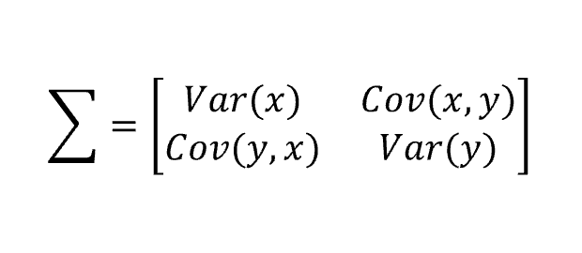
Covariance matrix computation
Covariance matrix is used to express the correlation between two or more variables.
Positive Covariance indicate that the value of one variable is directly proportional to other variable .
Negative Covariance indicate that the value of one variable is inversely proportional to other variable .

Slide 12
Eigen values
Proportion of acceptance level of different principal components.
Eigen values are the scalers or the magnitude of the eigen vectors.
It represents the units of spread captured by each PC.
PCs are extracted in the descending order of Eigen values .

Slide 13
Eigen vectors
Identify the variables which are positively correlated with principal components. Increasing the values of different variables increase the first principal component.
It represents the direction in which PCs are aligned.

Slide 14

Example
Compute the principal components and reduce the dimensions from two to one using the principal component analysis. The data set are given:
Solution:
Step-01: compute the mean of x and y.
$\overline{x}$ = 8 and $\overline{y}$ = 8.5
x | 4 | 8 | 13 | 7
y | 11 | 4 | 5 | 14

Slide 15
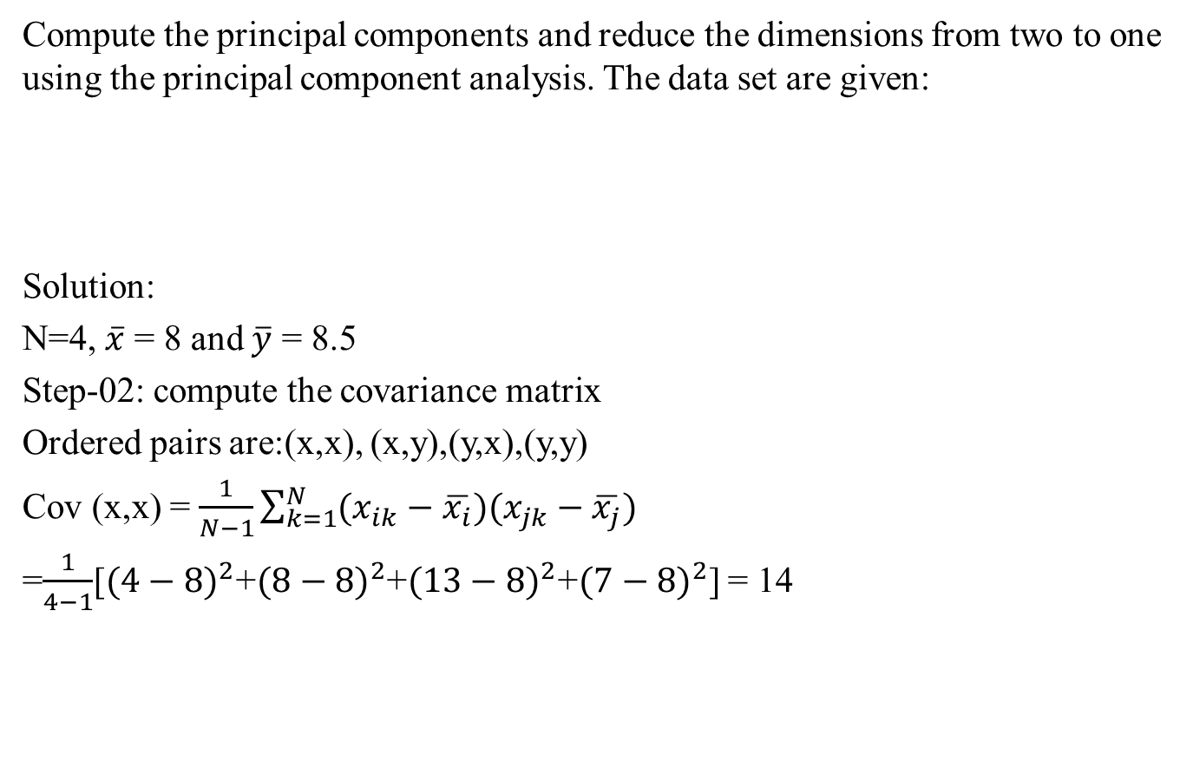
Example
Compute the principal components and reduce the dimensions from two to one using the principal component analysis. The data set are given:
Solution:
N=4, $\overline{x}$ = 8 and $\overline{y}$ = 8.5
Step-02: compute the covariance matrix
Ordered pairs are:(x,x), (x,y),(y,x),(y,y)
Cov (x,x) = $\frac{1}{N−1}\sum_{k=1}^{N}{(x_{ik}−\overline{x_{i}})(x_{jk}−\overline{x_{j}})}$
=$\frac{1}{4−1}$[${(4−8)}^{2}$+${(8−8)}^{2}$+${(13−8)}^{2}$+${(7−8)}^{2}$] = 14
x | 4 | 8 | 13 | 7
y | 11 | 4 | 5 | 14

Slide 16
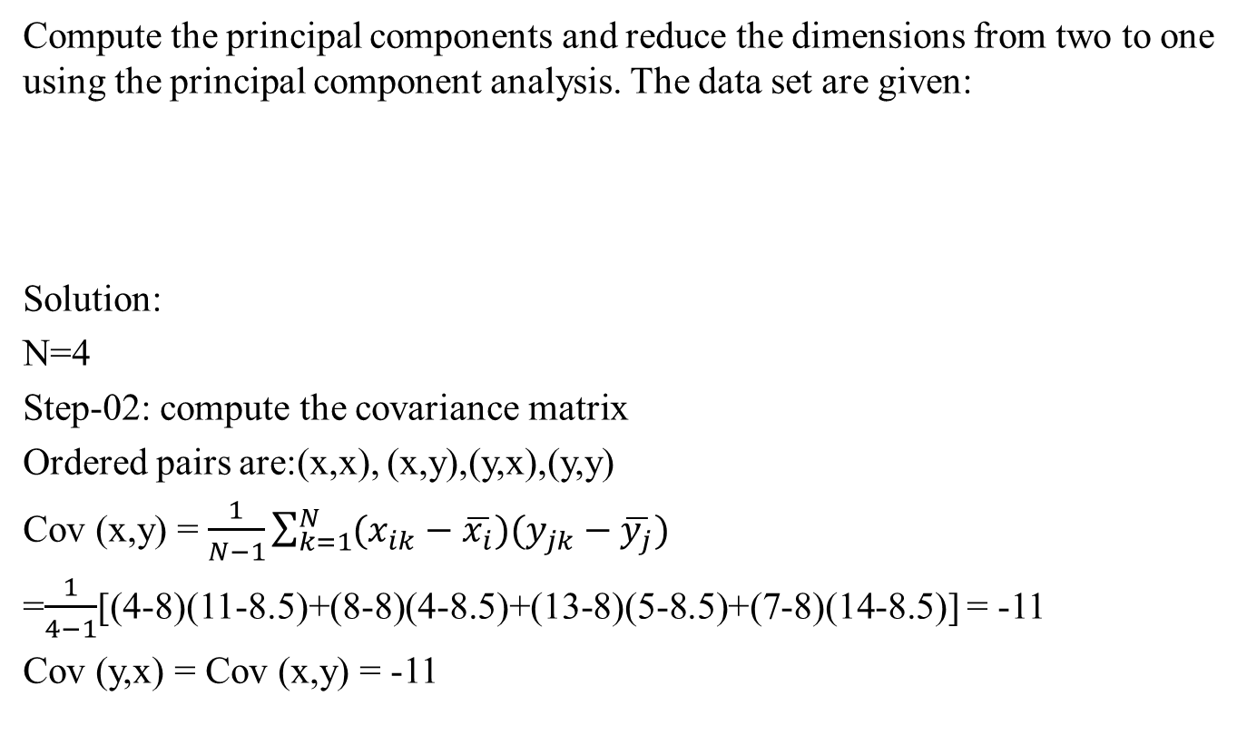
Example
Compute the principal components and reduce the dimensions from two to one using the principal component analysis. The data set are given:
Solution:
N=4
Step-02: compute the covariance matrix
Ordered pairs are:(x,x), (x,y),(y,x),(y,y)
Cov (x,y) = $\frac{1}{N−1}\sum_{k=1}^{N}{(x_{ik}−\overline{x_{i}})(y_{jk}−\overline{y_{j}})}$
=$\frac{1}{4−1}$[(4-8)(11-8.5)+(8-8)(4-8.5)+(13-8)(5-8.5)+(7-8)(14-8.5)] = -11
Cov (y,x) = Cov (x,y) = -11
x | 4 | 8 | 13 | 7
y | 11 | 4 | 5 | 14

Slide 17
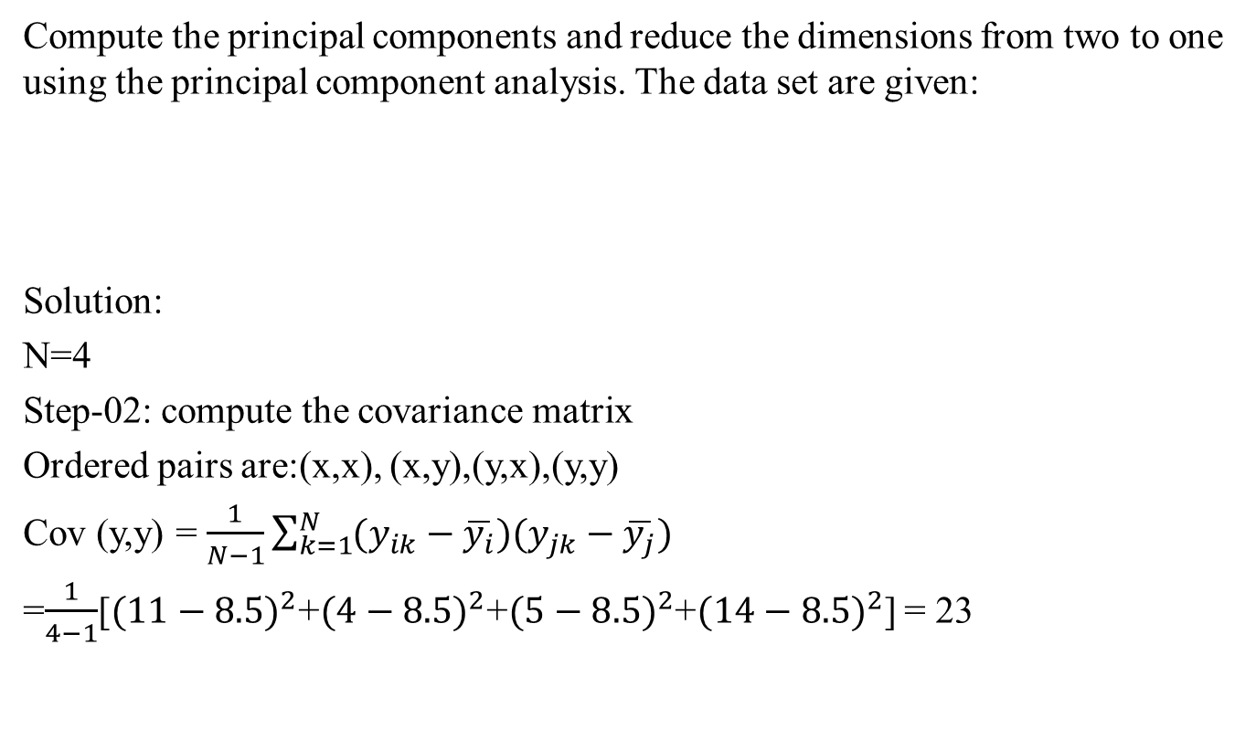
Example
Compute the principal components and reduce the dimensions from two to one using the principal component analysis. The data set are given:
Solution:
N=4
Step-02: compute the covariance matrix
Ordered pairs are:(x,x), (x,y),(y,x),(y,y)
Cov (y,y) = $\frac{1}{N−1}\sum_{k=1}^{N}{(y_{ik}−\overline{y_{i}})(y_{jk}−\overline{y_{j}})}$
=$\frac{1}{4−1}$[${(11−8.5)}^{2}$+${(4−8.5)}^{2}$+${(5−8.5)}^{2}$+${(14−8.5)}^{2}$] = 23
x | 4 | 8 | 13 | 7
y | 11 | 4 | 5 | 14

Slide 18
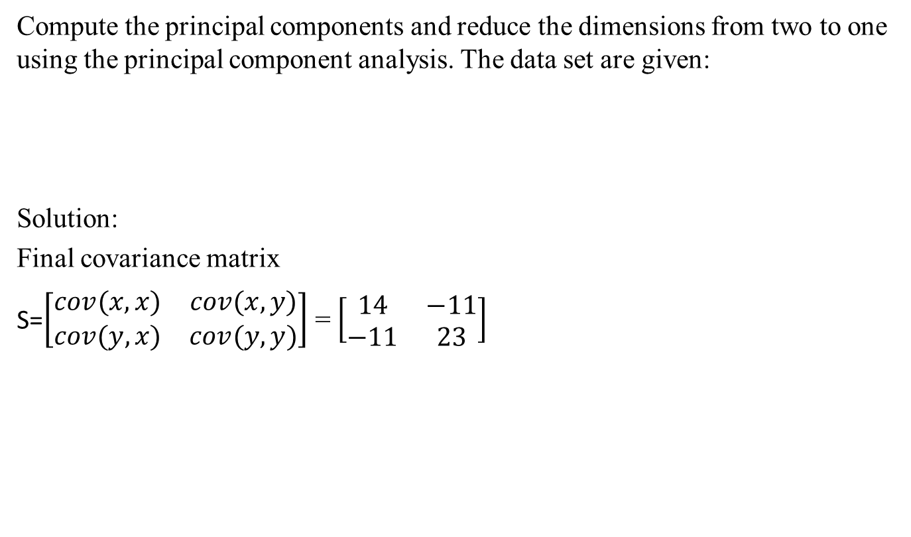
Example
Compute the principal components and reduce the dimensions from two to one using the principal component analysis. The data set are given:
Solution:
Final covariance matrix
S=$\left[\begin{matrix}cov(x,x) & cov(x,y) \\ cov(y,x) & cov(y,y)\end{matrix}\right]$ = $\left[\begin{matrix}14 & −11 \\ −11 & 23\end{matrix}\right]$
x | 4 | 8 | 13 | 7
y | 11 | 4 | 5 | 14

Slide 19
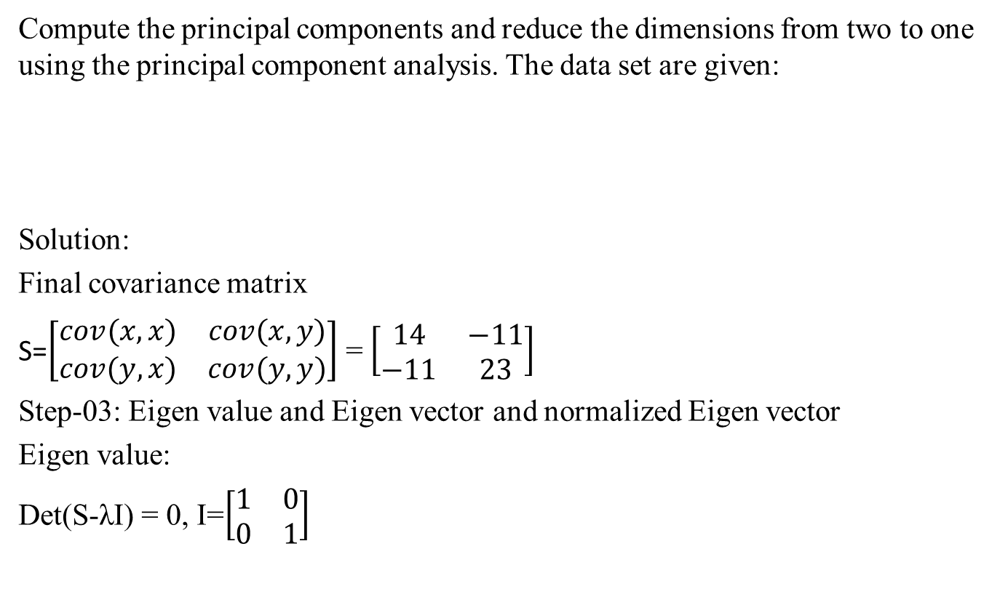
Example
Compute the principal components and reduce the dimensions from two to one using the principal component analysis. The data set are given:
Solution:
Final covariance matrix
S=$\left[\begin{matrix}cov(x,x) & cov(x,y) \\ cov(y,x) & cov(y,y)\end{matrix}\right]$ = $\left[\begin{matrix}14 & −11 \\ −11 & 23\end{matrix}\right]$
Step-03: Eigen value and Eigen vector and normalized Eigen vector
Eigen value:
Det(S-λI) = 0, I=$\left[\begin{matrix}1 & 0 \\ 0 & 1\end{matrix}\right]$
x | 4 | 8 | 13 | 7
y | 11 | 4 | 5 | 14

Slide 20
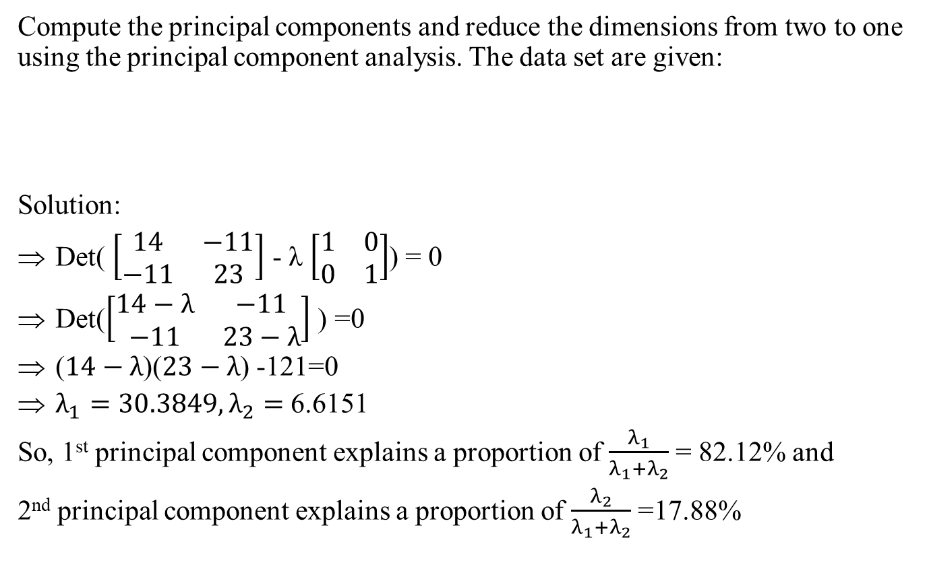
Example
Compute the principal components and reduce the dimensions from two to one using the principal component analysis. The data set are given:
Solution:
Det( $\left[\begin{matrix}14 & −11 \\ −11 & 23\end{matrix}\right]$ - λ $\left[\begin{matrix}1 & 0 \\ 0 & 1\end{matrix}\right]$) = 0
Det($\left[\begin{matrix}14−λ & −11 \\ −11 & 23−λ\end{matrix}\right]$ ) =0
($14−λ$)($23−λ$) -121=0
$λ_{1}=30.3849, λ_{2}=$ 6.6151
So, 1st principal component explains a proportion of $\frac{λ_{1}}{λ_{1}+λ_{2}}$ = 82.12% and
2nd principal component explains a proportion of $\frac{λ_{2}}{λ_{1}+λ_{2}}$ =17.88%
x | 4 | 8 | 13 | 7
y | 11 | 4 | 5 | 14

Slide 21

Example
Eigen vector of $λ_{1}$
(S- $λ_{1}$I) $U_{1}$= 0
( $\left[\begin{matrix}14 & −11 \\ −11 & 23\end{matrix}\right]$ - $λ_{1}$ $\left[\begin{matrix}1 & 0 \\ 0 & 1\end{matrix}\right]$) [$\begin{matrix}u_{1} \\ u_{2}\end{matrix}$] = 0
$\left[\begin{matrix}14−λ_{1} & −11 \\ −11 & 23−λ_{1}\end{matrix}\right]$ [$\begin{matrix}u_{1} \\ u_{2}\end{matrix}$] = 0
$\left[\begin{matrix}(14−λ_{1})u_{1} & −11u_{2} \\ −11u_{1} & (23−λ_{1})u_{2}\end{matrix}\right]$ = [$\begin{matrix}0 \\ 0\end{matrix}$]
(14-$λ_{1})u_{1}$ - $11u_{2}$ =0
and $−11u_{1}$+$(23−λ_{1})u_{2}$ = 0

Slide 22

Example
Eigen vector of $λ_{1}$
(14-$λ_{1})u_{1}$ - $11u_{2}$ =0
(14-$λ_{1})u_{1}$ = $11u_{2}$
$u_{1}$/11 = $u_{2}$/(14-$λ_{1}$) = t
When t= 1
$u_{1}$ =11, $u_{2}$ =14-$λ_{1}$
So our eigen vector $u_{1}$ of $λ_{1}$ = [$\begin{matrix}11 \\ \text{14−}λ_{1}\end{matrix}$]
[$\begin{matrix}11 \\ \text{14−}30.3849\end{matrix}$]
[$\begin{matrix}11 \\ \text{−16.38}49\end{matrix}$]

Slide 23
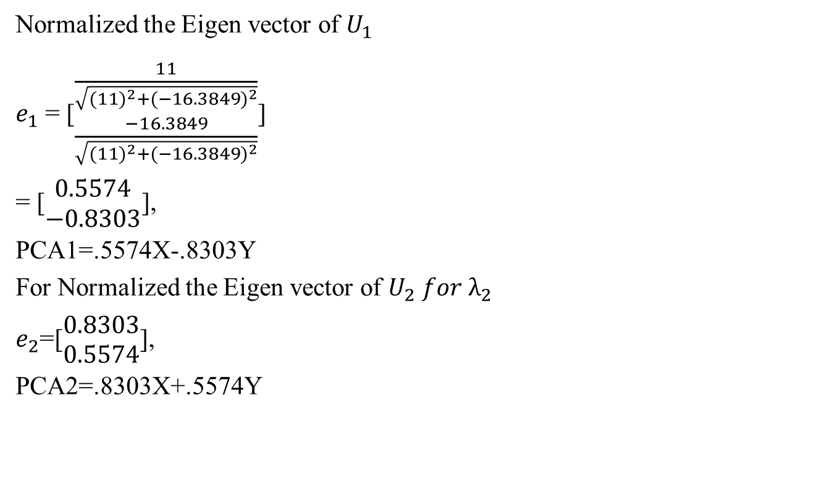
Example
Normalized the Eigen vector of $U_{1}$
$e_{1}$ = [$\begin{matrix}\frac{11}{\sqrt{{(11)}^{2}+{(−16.3849)}^{2}}} \\ \frac{−16.3849}{\sqrt{{(11)}^{2}+{(−16.3849)}^{2}}}\end{matrix}$]
= [$\begin{matrix}0.5574 \\ −0.8303\end{matrix}$],
PCA1=.5574X-.8303Y
For Normalized the Eigen vector of $U_{2} for λ_{2}$
$e_{2}$=[$\begin{matrix}0.8303 \\ 0.5574\end{matrix}$],
PCA2=.8303X+.5574Y

Slide 24
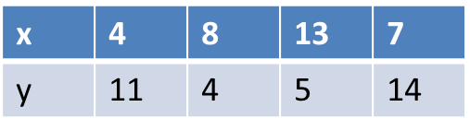

Example
Step-04: derive new dataset,
Original dataset, , $\overline{x}$ = 8 and $\overline{y}$ = 8.5,
P11= $e_{1}^{T}[\begin{matrix}4−8 \\ 11−8.5\end{matrix}$]
= [0.5574 -0.8303] $[\begin{matrix}−4 \\ 2.5\end{matrix}$]
= -4.3052
P12 = 3.7361
P13 = 5.6928
P14 = -5.1238
PCA1 | P11 | P12 | P13 | P14
PCA1 | -4.3052 | 3.7361 | 5.6928 | -5.1238

